Slide 1
Statements, Expressions And Operators In C#

Slide 2
STATEMENTS
A C# program is a set of tasks that perform to achieve the overall functionality of the program.
To perform the tasks, programmers provide instructions. These instructions are called statements.
A C# statement can contain expressions that evaluates to a value.

Slide 3
STATEMENTS
Statements are referred to as logical grouping of variables, operators, and C# keywords that perform a specific task.
For example, the line which initializes a variable by assigning it a value is a statement.
In C#, a statement ends with a semicolon.
A C# program contains multiple statements grouped in blocks. A block is a code segment enclosed in curly braces.

Slide 4
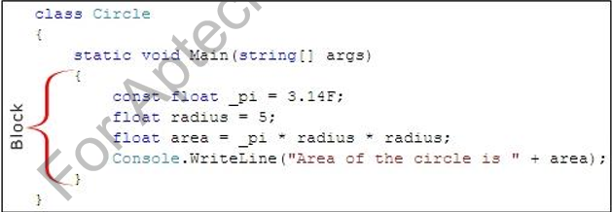
STATEMENTS
For example, the set of statements included in the Main() method of a C# code is a block.

Slide 5
STATEMENTS
Statements are used to specify the input, the process, and the output tasks of a program. Statements can consist of:
Data types
Variables
Operators
Constants
Literals
Keywords
Escape sequence characters

Slide 6
STATEMENTS
Statements help you build a logical flow in the program. With the help of statements, you can:
Initialize variables and objects
Take the input
Call a method of a class
Display the output

Slide 7
Types of Statements
Similar to statements in C and C++, the C# statements are
classified into several categories:
Selection Statements
Iteration Statements
Jump Statements
Exception Handling Statements

Slide 8
Expressions
Expressions are used to manipulate data. Like in mathematics, expressions in programming languages, including C#, are constructed from the operands and operators.
Example: 2 + 2
An expression statement in C# ends with a semicolon (;).
The following code demonstrates an example for expressions:
simpleInterest = principal * time * rate / 100;

Slide 9
Operators
Expressions in C# comprise one or more operators that performs some operations on variables.
An operation is an action performed on single or multiple values stored in variables in order to modify them or to generate a new value with the help of minimum one symbol and a value.
The symbol is called an operator and it determines the type of action to be performed on the value.

Slide 10
Operators
An operand might be a complex expression. For example, (X * Y) + (X – Y) is a complex expression, where the + operator is used to join two operands.
The value on which the operation is to be performed is called an operand.

Slide 11
Operators
Operators are used to simplify expressions.
In C#, there is a predefined set of operators used to perform various types of operations.
These are classified into seven categories based on the action they perform on values:
Arithmetic Operators
Relational Operators
Logical Operators
Bitwise Operators
Conditional Operators
Increment and Decrement Operators
Assignment Operators

Slide 12
Classification Of Operators
Operators are classify into 3 categories:
1. UNARY OPERATORS
2. BINARY OPERATORS
3. TERNARY OPERATORS

